Slide 1
CHAPTER 2
ARTIFICIAL NEURAL NETWORKS: AN INTRODUCTION
Computer Science and Engineering, VJCET, Vazhakulam

Slide 2
DEFINITION OF NEURAL NETWORKS
According to the DARPA Neural Network Study (1988, AFCEA International Press, p. 60):
• ... a neural network is a system composed of many simple processing elements operating in parallel whose function is determined by network structure, connection strengths, and the processing performed at computing elements or nodes.
According to Haykin (1994), p. 2:
A neural network is a massively parallel distributed processor that has a natural propensity for storing experiential knowledge and making it available for use. It resembles the brain in two respects:
Knowledge is acquired by the network through a learning process.
Interneuron connection strengths known as synaptic weights are used to store the knowledge.
Computer Science and Engineering, VJCET, Vazhakulam

Slide 3
Neural Networks
Neural network was inspired by the design and functioning of human brain and components.
Definition:
Information processing model that is inspired by the way biological nervous system (i.e) the brain, process information.
ANN is composed of large number of highly interconnected processing elements(neurons) working in union to solve problems.
It is configured for special application such as pattern recognition and data classification through a learning process.
85-90% accurate.
Computer Science and Engineering, VJCET, Vazhakulam

Slide 4
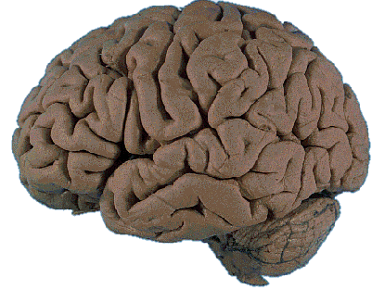
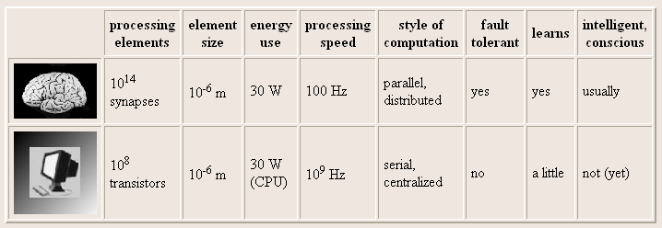
BRAIN COMPUTATION
The human brain contains about 10 billion nerve cells, or neurons. On average, each neuron is connected to other neurons through approximately 10,000 synapses.
Computer Science and Engineering, VJCET, Vazhakulam

Slide 5
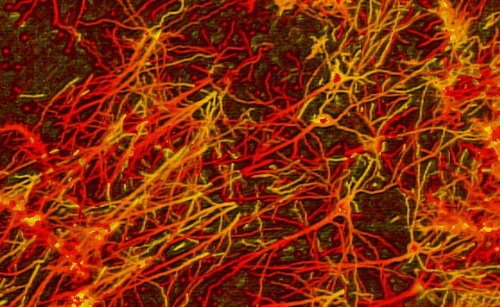
INTERCONNECTIONS IN BRAIN
Computer Science and Engineering, VJCET, Vazhakulam

Slide 6
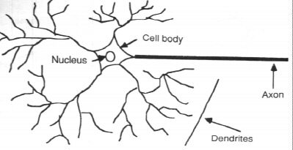
BIOLOGICAL NEURAL NETWORK
Human brain consist of a huge number of neurons, appx 10 ^11 , with numerous interconnections
Consist of 3 main parts
  Soma/cell body where cell nucleus is located
  Dendrites where nerve is connected to cell body
  Axon which carries the impulse of neuron
Computer Science and Engineering, VJCET, Vazhakulam

Slide 7
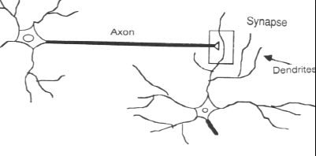
In the human brain, a typical neuron collects signals from others through a host of fine structures called dendrites.
The neuron sends out spikes of electrical activity through a long, thin stand known as an axon, which splits into thousands of branches.
At the end of each branch, a structure called a synapse converts the activity from the axon into electrical effects that inhibit or excite activity in the connected neurons.
Computer Science and Engineering, VJCET, Vazhakulam

Slide 8
Electric impulse is passed between synapse and dendrites.
Synapse- Axon split into strands and strands terminates into small bulb like organs called as synapse.
It is a chemical process which results in increase /decrease in the electric potential inside the body of the receiving cell.
If the electric potential reaches a threshold value, receiving cell fires & pulse / action potential of fixed strength and duration is send out through the axon to synaptic junction of the cell.
After that, cell has to wait for a period called refractory period.
Synapses are said to be
  Inhibitory if the parsing impulses prevent the firing of receiving cell
  Excitatory If the parsing impulses cause the firing of cells
Computer Science and Engineering, VJCET, Vazhakulam

Slide 9
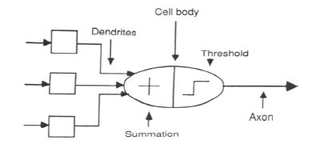
ASSOCIATION OF BIOLOGICAL NET
WITH ARTIFICIAL NET
Computer Science and Engineering, VJCET, Vazhakulam

Slide 10

Figure below shows the mathematical representation of above discussed chemical reaction taking place in an artificial neuron
The net input is calculated as
X₁
W1
Y
X₂
W2
∑ y _{in}
Output
y
Wn
Processing Element
X_{N}
Computer Science and Engineering, VJCET, Vazhakulam

Slide 11
The weight represent the strength of the synapse connecting input and the output neuron
A positive weight corresponds to the excitatory synapses
A negative weight corresponds to the inhibitory synapses
Computer Science and Engineering, VJCET, Vazhakulam

Slide 12
ARTIFICIAL NEURAL NET
Information-processing system.
Neurons process the information.
The signals are transmitted by means of connection links.
The links possess an associated weight.
The output signal is obtained by applying activations to the net input.
Computer Science and Engineering, VJCET, Vazhakulam

Slide 13
MOTIVATION FOR NEURAL NET
  Scientists are challenged to use machines more effectively for tasks currently solved by humans.
  Symbolic rules don't reflect processes actually used by humans.
  Traditional computing excels in many areas, but not in others.
Computer Science and Engineering, VJCET, Vazhakulam

Slide 14
  The major areas being:
  Massive parallelism
  Distributed representation and computation
  Learning ability
  Generalization ability
  Adaptivity
  Inherent contextual information processing
  Fault tolerance
  Low energy consumption.
Computer Science and Engineering, VJCET, Vazhakulam

Slide 15
Artificial Neural Network : An Introduction
Resembles the characteristic of biological neural network.
Nodes – interconnected processing elements (units or neurons)
Neuron is connected to other by a connection link.
Each connection link is associated with weight which has information about the input signal.
ANN processing elements are called as neurons or artificial neurons , since they have the capability to model networks of original neurons as found in brain.
Internal state of neuron is called activation or activity level of neuron, which is the function of the inputs the neurons receives.
Neuron can send only one signal at a time.
Computer Science and Engineering, VJCET, Vazhakulam

Slide 16
Basic Operation of a Neural Net
X1 and X2 – input neurons.
Y- output neuron
Weighted interconnection links- W1 and W2.
Net input calculation is :
Output is :
Output= function (net input calculated)
W₁
X₁
Y
W₂
X₂
Computer Science and Engineering, VJCET, Vazhakulam

Slide 17
The function to be applied over the net input is called activation function.
Weight involved in ANN is equal to the slope of linear straight line (y=mx).
To obtain y , the slop of m is directly multiplied with the input signal.
This is linear equation when the slop and input is linearly varied
This shows that the weight involved in ANN is equivalent to the slop of linear straight line
INPUT
X
Y
m
mx
Computer Science and Engineering, VJCET, Vazhakulam

Slide 18
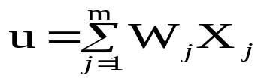

PROCESSING OF AN ARTIFICIAL NET
The neuron is the basic information processing unit of a NN. It consists of:
1. A set of links, describing the neuron inputs, with weights W₁, W₂, …, W_{m}.
2. An adder function (linear combiner) for computing the weighted sum of the inputs (real numbers):
3. Activation function for limiting the amplitude of the neuron output.
Computer Science and Engineering, VJCET, Vazhakulam

Slide 19
BIAS OF AN ARTIFICIAL NEURON
The bias value is added to the weighted sum
∑w_{i}x_{i} so that we can transform it from the origin.
Y_{in} = ∑w_{i}x_{i} + b, where b is the bias
x₁-x₂= -1
x₂
x₁-x₂=0
x₁-x₂= 1
x₁
Computer Science and Engineering, VJCET, Vazhakulam

Slide 20
Terminology Relation Between Biological And Artificial Neuron
Biological Neuron | Artificial Neuron
Cell | Neuron
Dendrites | Weights or interconnections
Soma | Net input
Axon | Output
Computer Science and Engineering, VJCET, Vazhakulam

Slide 21
Brain Vs computer
Term | Brain | Computer
Speed | Execution time is few milliseconds | Execution time is few nano seconds
Processing | Perform massive parallel operations simultaneously | Perform several parallel operations simultaneously. It is faster the biological neuron
Size and complexity | Number of Neuron is 10¹¹ and number of interconnections is 10¹⁵. So complexity of brain is higher than computer | It depends on the chosen application and network designer.
Storage capacity | i) Information is stored in interconnections or in synapse strength. ii) New information is stored without destroying old one. iii) Sometimes fails to recollect information | Stored in continuous memory location. Overloading may destroy older locations. Can be easily retrieved
Tolerance | Fault tolerant Store and retrieve information even interconnections fails Accept redundancies | No fault tolerance Information corrupted if the network connections disconnected. No redundancies
Control mechanism | Depends on active chemicals and neuron connections are strong or weak | CPU Control mechanism is very simple
Computer Science and Engineering, VJCET, Vazhakulam

Slide 22
Characteristics of ANN:
Neurally implemented mathematical model
Large number of processing elements called neurons exists here.
Interconnections with weighted linkage hold informative knowledge.
Input signals arrive at processing elements through connections and connecting weights.
Processing elements can learn, recall and generalize from the given data.
Computational power is determined by the collective behavior of neurons.
  ANN is a connection models, parallel distributed processing models, self-organizing systems, neuro-computing systems and neuro morphic system.
Computer Science and Engineering, VJCET, Vazhakulam

Slide 23
Evolution of neural networks
Year | Neural network | Designer | Description
1943 | McCulloch and Pitts neuron | McCulloch and Pitts | Arrangement of neurons is combination of logic gate. Unique feature is threshold
1949 | Hebb network | Hebb | If two neurons are active, then their connection strengths should be increased.
1958,1959,1962,1988,1960 | Perceptron Adaline | Frank Rosenblatt, Block, Minsky and Papert Widrow and Hoff | Weights are adjusted to reduce the difference between the net input to the output unit and the desired output
1972 | Kohonen self-organizing feature map | Kohonen | Inputs are clustered to obtain a fired output neuron.
1982,1984, 1985,1986,1987 | Hopfield network | John Hopfield and Tank | Based on fixed weights. Can act as associative memory nets
1986 | Back propagation network | Rumelhart, Hinton and Williams | Multilayered Error propagated backward from output to the hidden units
Computer Science and Engineering, VJCET, Vazhakulam

Slide 24
Year | Neural network | Designer | Description
1988 | Counter propagation network | Grossberg | Similar to kohonen network
1987-1990 | Adaptive resonance Theory(ART) | Carpenter and Grossberg | Designed for binary and analog inputs.
1988 | Radial basis function network | Broomhead and Lowe | Resemble back propagation network , but activation function used is Gaussian function
1988 | Neo cognitron | Fukushima | For character recogniton.
Computer Science and Engineering, VJCET, Vazhakulam

Slide 25
Basic models of ann
Models are based on three entities
  The model’s synaptic interconnections.
  The training or learning rules adopted for updating and adjusting the connection weights.
  Their activation functions
Computer Science and Engineering, VJCET, Vazhakulam

Slide 26
CONNECTION
The arrangement of neurons to form layers and the connection pattern formed within and between layers is called the network architecture.
Five types:
  Single layer feed forward network
  Multilayer feed-forward network
  Single node with its own feedback
  Single-layer recurrent network
  Multilayer recurrent network
Computer Science and Engineering, VJCET, Vazhakulam

Slide 27
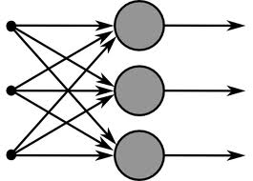
Single layer Feed- Forward Network
Layer is formed by taking processing elements and combining it with other processing elements.
Input and output are linked with each other
Inputs are connected to the processing nodes with various weights, resulting in series of outputs one per node.
Computer Science and Engineering, VJCET, Vazhakulam

Slide 28
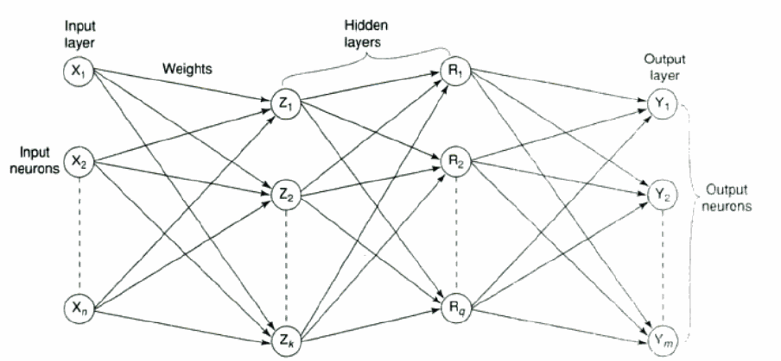
Multilayer feed-forward network
Formed by the interconnection of several layers.
Input layer receives input and buffers input signal.
Output layer generated output.
Layer between input and output is called hidden layer.
Hidden layer is internal to the network.
Zero to several hidden layers in a network.
More the hidden layer, more is the complexity of network, but efficient output is produced.
Computer Science and Engineering, VJCET, Vazhakulam

Slide 29
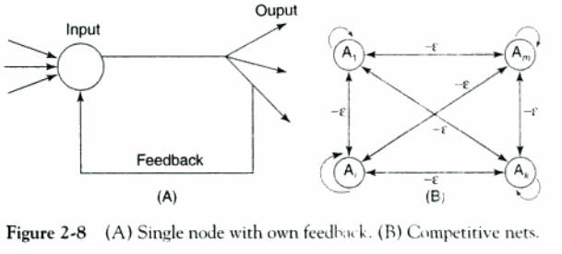
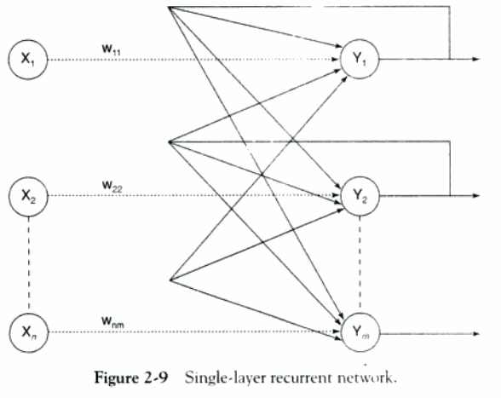
Feed back network
If no neuron in the output layer is an input to a node in the same layer / proceeding layer – feed forward network.
If outputs are directed back as input to the processing elements in the same layer/proceeding layer –feedback network.
If the output are directed back to the input of the same layer then it is lateral feedback.
Recurrent networks are networks with feedback networks with closed loop.
Fig 2.8 (A) –simple recurrent neural network having a single neuron with feedback to itself.
Fig 2.9 – single layer network with feedback from output can be directed to processing element itself or to other processing element/both.
Computer Science and Engineering, VJCET, Vazhakulam

Slide 30
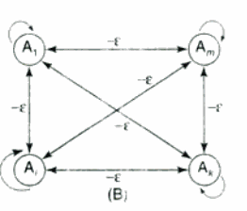
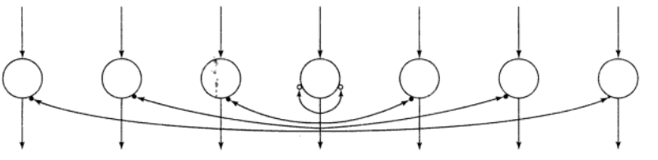
Maxnet – competitive interconnections having fixed weights.
On-center-off-surround/lateral inhibiton structure – each processing neuron receives two different classes of inputs- “excitatory” input from nearby processing elements & “ inhibitory” elements from more distantly located precessing elements. This type of interconnection is shown below
Computer Science and Engineering, VJCET, Vazhakulam

Slide 31
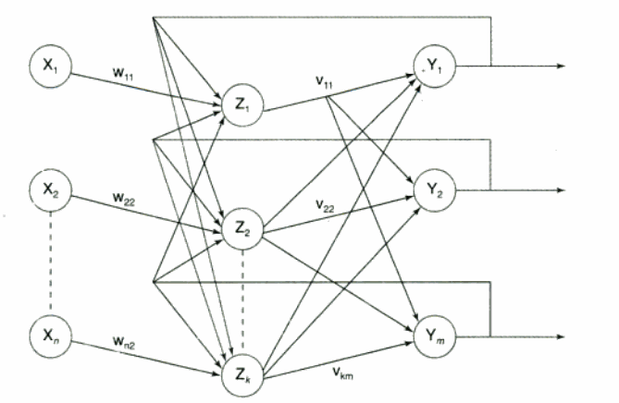
Processing element output can be directed back to the nodes in the preceding layer, forming a multilayer recurrent network.
Processing element output can be directed to processing element itself or to other processing element in the same layer.
Computer Science and Engineering, VJCET, Vazhakulam

Slide 32
learning
The main property of ANN
NN adapt itself to a stimulus by making proper parameter adjustments resulting in the production of desired response
Two broad kinds of learning in ANNs is :
  parameter learning – updates connecting weights in a neural net.
  Structure learning – focus on change in the network which include the number of processing elements and their connection type
Apart from these, learning in ANN is classified into three categories as
      i) supervised learning
      ii) unsupervised learning
      Iii) reinforcement learning
Computer Science and Engineering, VJCET, Vazhakulam

Slide 33
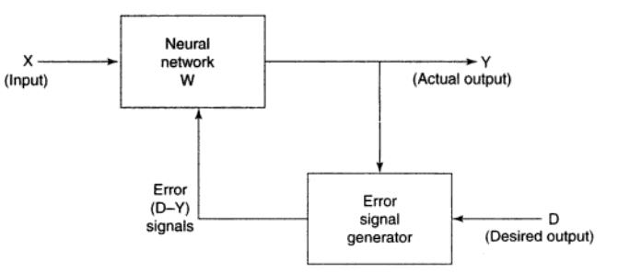
Supervised learning
Learning with the help of a teacher.
Example : learning process of a small child.
  Child doesn’t know read/write.
  Their each & every action is supervised by a teacher
In ANN, each input vector requires a corresponding target vector, which represents the desired output.
The input vector along with target vector is called training pair.
The input vector results in output vector.
The actual output vector is compared with desired output vector.
If there is a difference means an error signal is generated by the network.
It is used for adjustment of weights until actual output matches desired output.
Computer Science and Engineering, VJCET, Vazhakulam

Slide 34
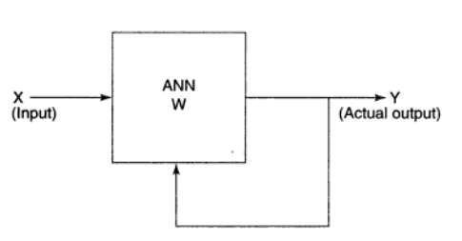
Unsupervised learning
Learning is performed without the help of a teacher.
Example: tadpole – learn to swim by itself.
In ANN, during training process, network receives input patterns and organize it to form clusters.
From the Fig. it is observed that no feedback is applied from environment to inform what output should be or whether they are correct.
The network itself discover patterns, regularities, features/ categories from the input data and relations for the input data over the output.
Exact clusters are formed by discovering similarities & dissimilarities so called as self – organizing.
Computer Science and Engineering, VJCET, Vazhakulam

Slide 35
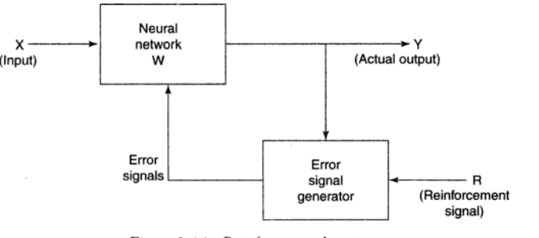
Reinforcement learning
Similar to supervised learning.
Learning based on critic information is called reinforcement learning & the feedback sent is called reinforcement signal.
The network receives some feedback from the environment.
Feedback is only evaluative.
The external reinforcement signals are processed in the critic signal generator, and the obtained critic signals are sent to the ANN for adjustment of weights properly to get critic feedback in future.

Slide 36
Activation functions
To make work more efficient and for exact output, some force or activation is given.
Like that, activation function is applied over the net input to calculate the output of an ANN.
Information processing of processing element has two major parts: input and output.
An integration function (f) is associated with input of processing element.
The nonlinear activation function is used to ensure that a neuron’s response is bounded
When a signal is fed through a multilayer network with a linear activation functions the output obtained remains the same as that could be obtained using a single layer network
Due to this reason , nonlinear functions are widely used in multilayer network compared to linear function
Computer Science and Engineering, VJCET, Vazhakulam

Slide 37

Several activation functions are there.
  1. Identity function:
    it is a linear function which is defined as
    f(x) =x for all x
    The output is same as the input.
  2. Binary step function
    it is defined as
    where θ represents thresh hold value.
    It is used in single layer nets to convert the net input to an output that is binary. ( 0 or 1)
Computer Science and Engineering, VJCET, Vazhakulam

Slide 38


3. Bipolar step function:
It is defined as
where θ represents threshold value
used in single layer nets to convert the net input to an output that is bipolar (+1 or -1).
4. Sigmoid function
used in Back propagation nets.
Two types:
a) binary sigmoid function
-logistic sigmoid function or unipolar sigmoid function.
-it is defined as
where λ – steepness parameter.
-The derivative of this function is
f’(x) = λ f(x)[1-f(x)].
The range of sigmoid function is 0 to 1.
Computer Science and Engineering, VJCET, Vazhakulam

Slide 39




b) Bipolar sigmoid function
where λ- steepness parameter and the sigmoid range is between -1 and +1.
- The derivative of this function can be
[1+f(x)][1-f(x)]
- It is closely related to hyperbolic tangent function, which is written as
The derivative of the hyperbolic tangent function is
h’(x)= [1+h(x))][1-h(x)]
Computer Science and Engineering, VJCET, Vazhakulam

Slide 40

5. Ramp function
The graphical representation of all these function is given in the upcoming Figure
Computer Science and Engineering, VJCET, Vazhakulam

Slide 41
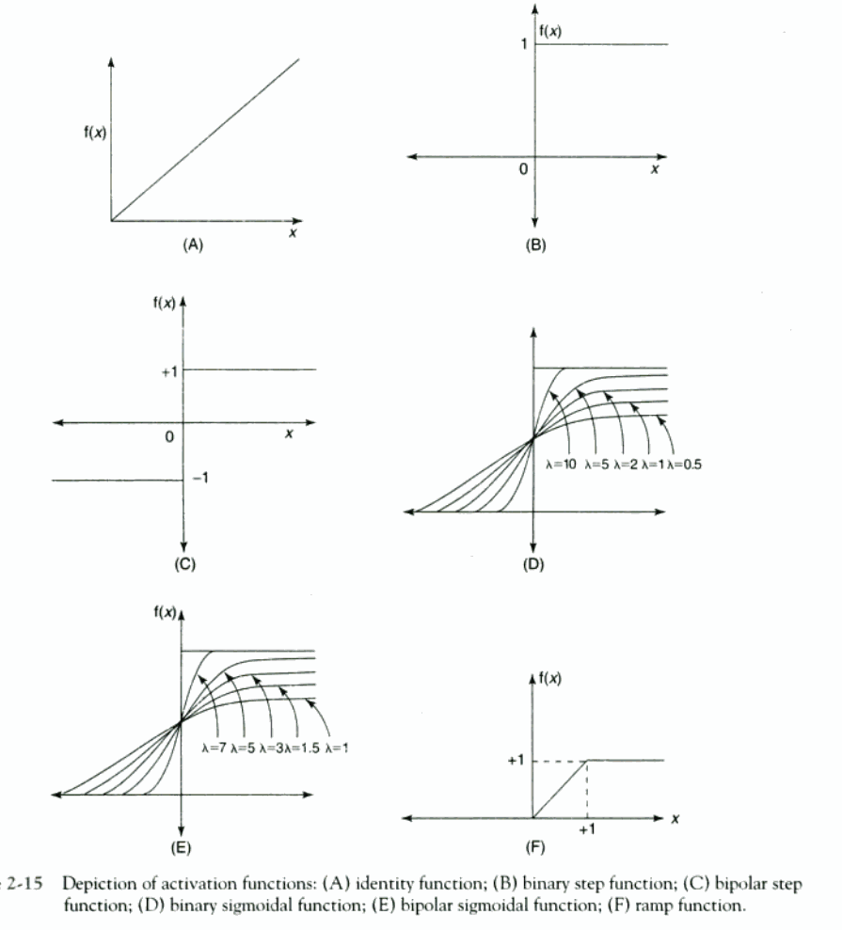
Computer Science and Engineering, VJCET, Vazhakulam

Slide 42
Important terminologies
Weight
  The weight contain information about the input signal.
  It is used by the net to solve the problem.
  It is represented in terms of matrix & called as connection matrix.
  If weight matrix W contains all the elements of an ANN, then the set of all W matrices will determine the set of all possible information processing configuration.
  The ANN can be realized by finding an appropriate matrix W.
  Weight encode long-term memory (LTM) and the activation states of network encode short-term memory (STM) in a neural network.
Computer Science and Engineering, VJCET, Vazhakulam

Slide 43
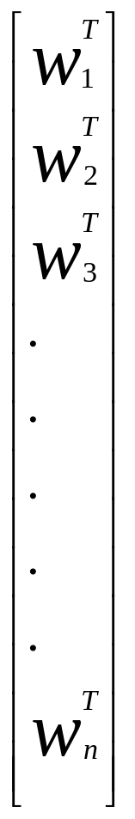
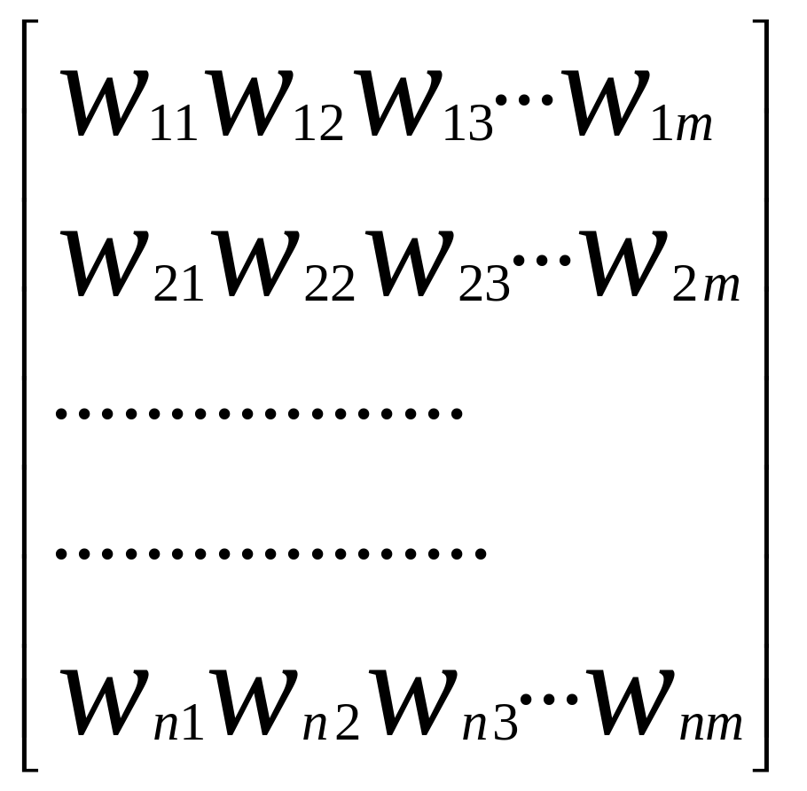
Weight matrix
W=
=
Computer Science and Engineering, VJCET, Vazhakulam

Slide 44
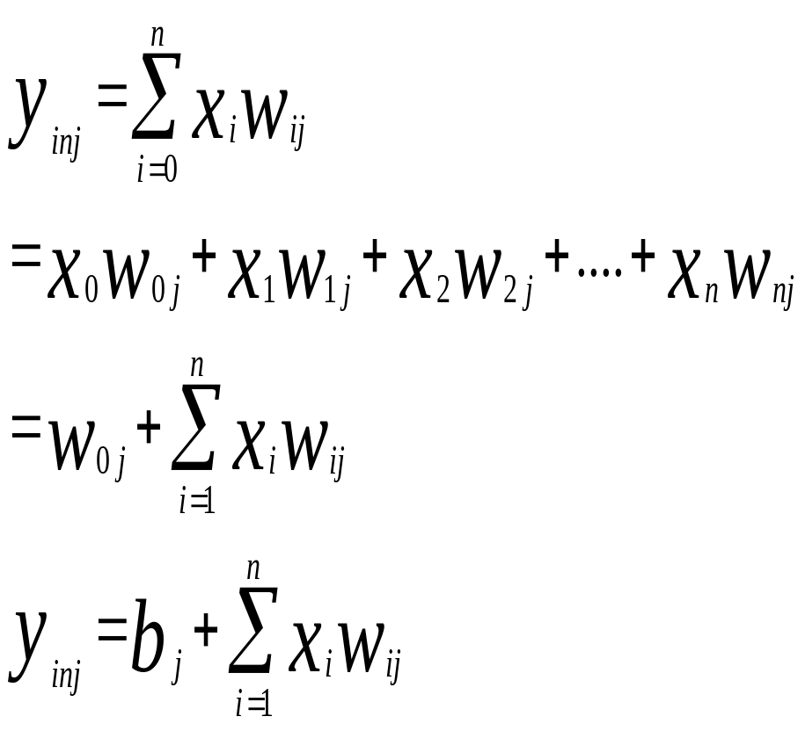
Weights contd…
w_{ij –}is the weight from processing element ”i” (source node) to processing element “j” (destination node)
1
X₁
b_{j}
w_{1j}
X_{i}
Y_{j}
w_{ij}
X_{n}
w_{nj}
Computer Science and Engineering, VJCET, Vazhakulam

Slide 45


Bias
  Bias has an impact in calculating net input.
  Bias is included by adding x₀ to the input vector x.
  The net output is calculated by
  The bias is of two types
      Positive bias
        Increase the net input
      Negative bias
        Decrease the net input
Computer Science and Engineering, VJCET, Vazhakulam

Slide 46

Threshold
  It is a set value based upon which the final output is calculated.
  Calculated net input and threshold is compared to get the network output.
  The activation function of threshold is defined as
    where θ is the fixed threshold value
Computer Science and Engineering, VJCET, Vazhakulam

Slide 47
Learning rate
  Denoted by α.
  Control the amount of weight adjustment at each step of training.
  The learning rate range from 0 to 1.
  Determine the rate of learning at each step
Momentum Factor
  Convergence is made faster if a momentum factor is added to the weight updation process.
  Done in back propagation network.
Vigilance parameter
  Denoted by ρ.
  Used in Adaptive Resonance Theory (ART) network.
  Used to control the degree of similarity.
  Ranges from 0.7 to 1 to perform useful work in controlling the number of clusters.
Computer Science and Engineering, VJCET, Vazhakulam

Slide 48
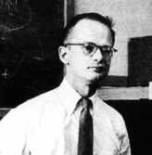
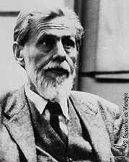
Mcculloch-pitts neuron
Discovered in 1943.
Usually called as M-P neuron.
M-P neurons are connected by directed weighted paths.
Activation of M-P neurons is binary (i.e) at any time step the neuron may fire or may not fire.
Weights associated with communication links may be excitatory(wgts are positive)/inhibitory(wgts are negative).
Threshold plays major role here. There is a fixed threshold for each neuron and if the net input to the neuron is greater than the threshold then the neuron fires.
They are widely used in logic functions.
Computer Science and Engineering, VJCET, Vazhakulam

Slide 49
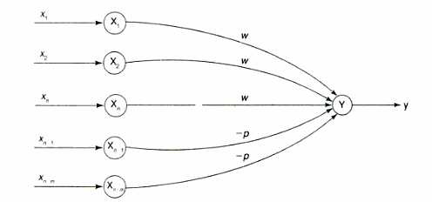

A simple M-P neuron is shown in the figure.
It is excitatory with weight (w>0) / inhibitory with weight –p (p<0).
In the Fig., inputs from x₁ to x_{n} possess excitatory weighted connection and X_{n+1} to x_{n+m} has inhibitory weighted interconnections.
Since the firing of neuron is based on threshold, activation function is defined as
Computer Science and Engineering, VJCET, Vazhakulam

Slide 50
For inhibition to be absolute, the threshold with the activation function should satisfy the following condition:
  θ >nw –p
Output will fire if it receives “k” or more excitatory inputs but no inhibitory inputs where
kw≥θ>(k-1) w
The M-P neuron has no particular training algorithm.
An analysis is performed to determine the weights and the threshold.
It is used as a building block where any function or phenomenon is modeled based on a logic function.
Computer Science and Engineering, VJCET, Vazhakulam

Slide 51
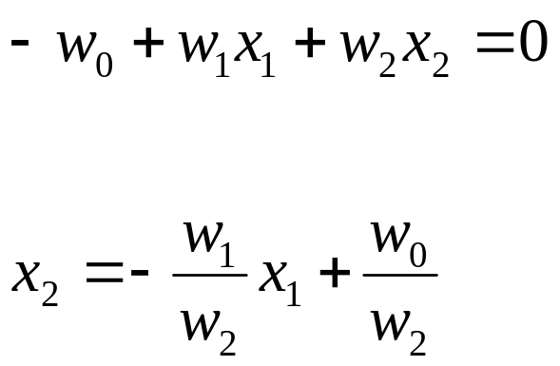
Linear Separability
Consider example with two inputs, x1, x2:
x₂
+
+
+
Can view trained network
as defining a “separation line”.
+
+
+
+
What is its equation?
x₁
Percepton used for classification

Slide 52
Linear Separability
x₂
+
+
?
OR
x₁
−
+

Slide 53
Linear Separability
x₂
−
?
+
AND
x₁
−
−

Slide 54
Linear Separability
x₂
+
?
−
XOR
x₁
−
+

Slide 55
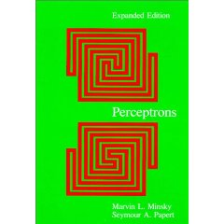
Linear Separability
x₂
Not linearly separable
+
−
XOR
x₁
−
+
Minsky & Papert (1969)
Bad News: Perceptrons can only represent linearly separable functions.

Slide 56


Linear separability
It is a concept wherein the separation of the input space into regions is based on whether the network response is positive or negative.
A decision line is drawn to separate positive or negative response.
The decision line is also called as decision-making line or decision-support line or linear-separable line.
The net input calculation to the output unit is given as
The region which is called as decision boundary is determined by the relation
Computer Science and Engineering, VJCET, Vazhakulam

Slide 57
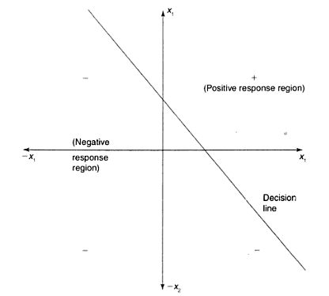
Consider a network having positive response in the first quadrant and negative response in all other quadrants with either binary or bipolar data.
Decision line is drawn separating two regions as shown in Fig.
Using bipolar data representation, missing data can be distinguished from mistaken data. Hence bipolar data is better than binary data.
Missing values are represented by 0 and mistakes by reversing the input values from +1 to -1 or vice versa.
Computer Science and Engineering, VJCET, Vazhakulam

Slide 58
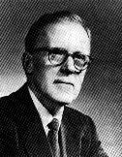
Hebb network
Donald Hebb stated in 1949 that “ In brain, the learning is performed by the change in the synaptic gap”.
When an axon of cell A is near enough to excite cell B, and repeatedly or permanently takes place in firing it, some growth process or metabolic change takes place in one or both the cells such than A’s efficiency, as one of the cells firing B, is increased.
According to Hebb rule, the weight vector is found to increase proportionately to the product of the input and the learning signal.
In Hebb learning, two interconnected neurons are ‘on’ simultaneously.
The weight update in Hebb rule is given by
        W_{i}(new) = w_{i} (old)+ x_{i} y.
It is suited more for bipolar data.
If binary data is used, the weight updation formula cannot distinguish two conditions namely
  A training pair in which an input unit is “on” and the target value is “off”
  A training pair in which both the input unit and the target value is “off”.
Computer Science and Engineering, VJCET, Vazhakulam

Slide 59
Flowchart of training algorithm
Computer Science and Engineering, VJCET, Vazhakulam

Slide 60
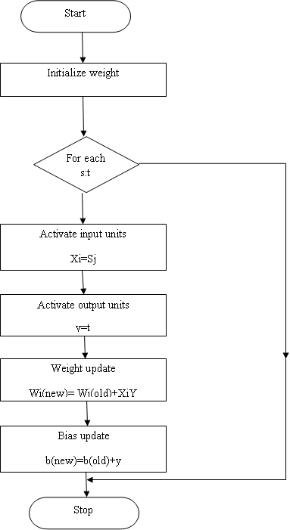
Computer Science and Engineering, VJCET, Vazhakulam

Slide 61
Computer Science and Engineering, VJCET, Vazhakulam
Steps:
  0: First initialize the weights.
  1: Steps 2-4 have to be performed for each input training vector and target output pair, s:t
  2: Input activations are set. The activation function for input layer is identity function.
      X_{i} =S_{i} for i=1 to n
  3: Output activations are set.
  4: Weight adjustment and bias adjustments are performed.
    W_{i}(new) = w_{i}(old)+x_{i}y
    b(new)=b(old)+y
In step 4, the weight updating formula can be written in vector form as
  w(new)=w(old)+y.
Change in weight is expressed as
  Δw=xy
  Hence,
  w(new)=w(old)+Δw
  Hebb rule is used for pattern association, pattern categorization, pattern classification and over a range of other areas

Slide 62
Construct a feed forward network with five input nodes, three hidden nodes and four output nodes

Slide 63
Construct a feed forward network with five input nodes, three hidden nodes and four output nodes that has lateral inhibition structure in the output layer

Slide 64
Construct a recurrent network with 4 input nodes, three hidden nodes and 2 output nodes that has a feedback link from hidden layer to input layer

Slide 65
+ | + | +
 | +
+ | + | +
Using Hebb rule, Find the weight required to perform the following classification of the given input patterns shown below
The pattern is shown as 3X3 matrix form in the squares. The “+” symbol represents the value 1 and empty square indicate -1.
Consider “I” belongs to the member of the class so the target value is 1 and “O” does not belongs to the member of the class so the target value is -1
“I”
+ | + | +
+ |  | +
+ | + | +
“O”

Slide 66
+ | . | .
+ | . | .
+ | + | +
Using Hebb rule, Find the weight required to perform the following classification of the given input patterns shown below
The pattern is shown as 3X3 matrix form in the squares. The “+” symbol represents the value 1 and dot indicate -1.
Consider “L” belongs to the member of the class so the target value is 1 and “U” does not belongs to the member of the class so the target value is -1
“L”
+ | . | +
+ | . | +
+ | + | +
“U”

Slide 67
+ | + | +
+ | . | +
+ | + | +
+ | . | +
+ | . | +
Using Hebb rule, Find the weight required to perform the following classification of the given input patterns shown below
The pattern is shown as 3X3 matrix form in the squares. The “+” symbol represents the value 1 and dot indicate -1.
Consider “A” belongs to the member of the class so the target value is 1 and “E” does not belongs to the member of the class so the target value is -1
“A”
+ | + | +
+ | . | .
+ | + | +
+ | . | .
+ | + | +
“E”

Slide 68
Using Hebb rule find weights required to perform following classifications. The vectors(1 -1 1 -1 ) and (1 1 1 -1) belongs to class (target value +1); vectors (-1 -1 1 1) and(1 1 -1 -1) do not belongs to class( target value -1). Also using each of training x vectors as input, test the response of the net

Slide 69
Distinguish between pattern “X” and pattern “O”
# |  |  |  | #
 | # |  | #
 |  | #
 | # |  | #
# |  |  |  | #
 | # | # | #
# |  |  |  | #
# |  |  |  | #
# |  |  |  | #
 | # | # | #

